Slide 1
''आप के हित में''
Evangelizing Empathy. Dealing with Stress. Focusing on Mindfulness
“

Slide 2
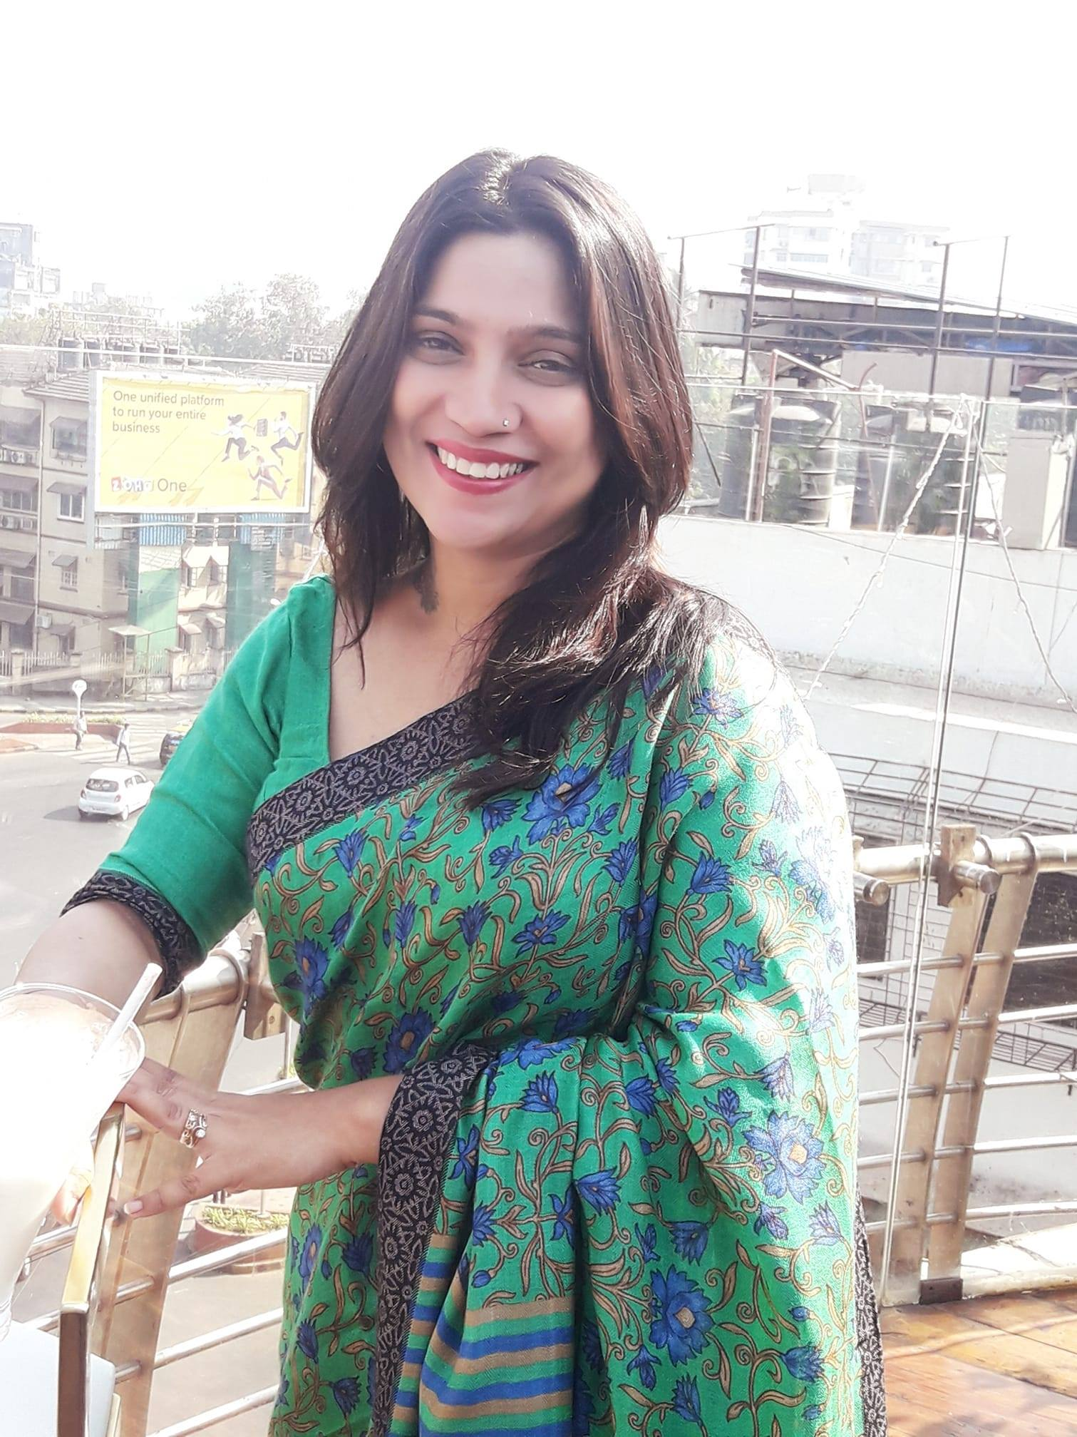
About the founder
Debolina Dutta is an educator, entrepreneur and a life and behavioral coach for children and adults. She is internationally certified in child psychology and developmental psychology and holds a degree in child education. She is the founder of Manners N Beyond LLP and MnB Next

Slide 3
Who are we
Manners N Beyond is a 7-year-old organization that is a pioneer in life-skills education for children and young adults in India.
MnB Next, is a vertical that imparts emotional and mental well-being programs for corporate employees, students and young adults, helping them to process a range of emotions mainly through story telling and other interactive sessions

Slide 4
Our Purpose
We believe that we can help people thrive through life’s challenges and set backs by providing innovative emotional well-being programs.

Slide 5
What's the construct
Empathy
Team collaboration
Work-life integration
Resilience
Growth mind-set
Uncertainty
Self development
Happiness at work
Self worth
Mindfulness in anger and anxiety
Gratitude
Our 3 hour interactive program for blue collar and junior employees on emotional and mental well-being includes topics such as:

Slide 6
How do we execute it…..
Each of these topics are explained through stories, games, worksheets, audio visual clips and simple fun and interactive sessions like art therapy and songs.
So far the content delivery is in hindi, bengali and english.
Due to the pandemic, all our programs are being conducted over zoom and ms team. We have recently started on-site training and the content can be tailor made to suit the company’s requirements

Slide 7
What will the participants achieve?
Heightened sense of awareness and sensitivity towards these issues, through impactful and insightful stories, which will make them introspect. Through the workshops, participants are expected to understand the construct of these emotions and how they all play a major role in creating winning teams.

Slide 8
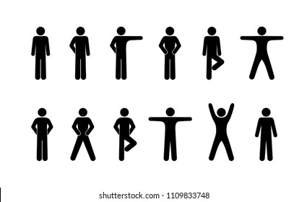
“Let’s loosen up and DO- UNDO !
Notes:
PUPPIES FOR SALE

Slide 9
हमदर्दी
EMPATHY
A story
“Empathy is about finding echoes of another person in yourself.”
Notes:
PUPPIES FOR SALE

Slide 10
उदासीनता
सहानुभूति
हमदर्दी
Apathy Sympathy, Empathy
Seek first to understand and then to be understood- Stephen Covey
Notes:
What comes to mind when you think of the word apathy?

Slide 11
THE POWEROF EMPATHY- A DEBRIEF
Notes:
If you look at the overall arch of your life, tell me about what role has empathy played, what insights did you learn along the way? Starting with your parents, did you feel empathy from them? When did you feel the deepest empathy? When didn’t you feel empathy?

Slide 12
A VISUAL METAPHOR
“What empathy means to you”
“Empathy” Can it be taught?

Slide 13
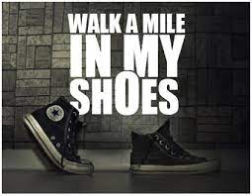
THE 8 GOLDEN RULES OF EMPATHY
Are you showing your CO-WORKERS enough support?
Notes:
Are you showing your employees enough support?

Slide 14
H
E
A
R
D
Hear. Empathize. Apologize. Resolve. Diagnose

Slide 15
Team COLLABORATION
.”
टीम नेतृत्व
Notes:
“Empathy is foundational to effective leadership. When we put ourselves in the shoes of another, we learn to do what’s right for those we lead”

Slide 16
STITCH THE STORY-
A TEAM ACTIVITY
Notes:
Team building activity

Slide 17
Break (10 minutes)
Notes:
story of a carrot, an egg and coffee beans

Slide 18
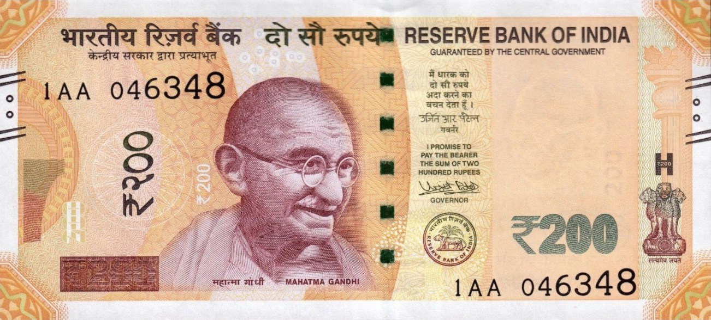
स्व मूल्य
SELF WORTH
A story
Notes:
A A

Slide 19
SELF WORTH- AN ACTIVITY
Notes:
Tell us an incident where you have walked in the other person’s shoes, at work place, with friends or at home

Slide 20
Notes:
Tell us an incident where you have walked in the other person’s shoes, at work place, with friends or at home

Slide 21
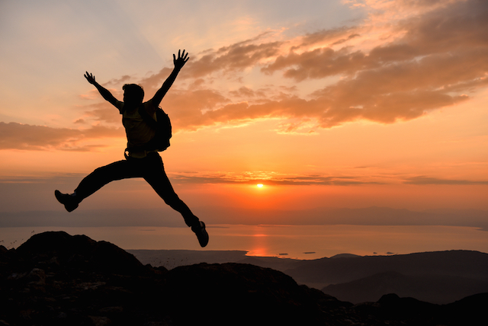
HAPPINESS AT WORK
Notes:
Tell us an incident where you have walked in the other person’s shoes, at work place, with friends or at home

Slide 22
Art therapy through finger painting
Expressing emotions
Notes:
Draw and paint the emotions using only your fingers

Slide 23
सचेतन
Mindfulness in anger and anxiety
A story
Notes:
Draw and paint the emotions using only your fingers

Slide 24
कृतज्ञता
A “Gratitude Wall” - An activity
Notes:
Draw and paint the emotions using only your fingers

Slide 25
Dealing with Uncertainty. Focusing on Growth Mindset
“

Slide 26
अनिश्चितता
“When nothing is certain, anything is possible.”
Uncertainty…… A story
Notes:
MAY BE YES, MAY BE NO

Slide 27
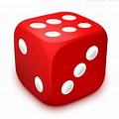
A DICE DEBRIEF ON UNCERTAINTY
Notes:
DICE DEBRIEF

Slide 28
A VISUAL METAPHOR
“What uncertainty means to you”

Slide 29
LET’S CHAT
Tools For Thriving In Uncertainty
Notes:
Ways To Deal With Uncertainty

Slide 30
FIND MEANING IN THE CHAOS- SETTING YOUR GOALS
 | Today | Next Week | Next Month | Next Year | In Five Years
For Me
For the world
Notes:
What kind of a person will Sonali grow up to be?

Slide 31
STITCH THE STORY FROM UNCERTAINTY TO HOPE….

Slide 32
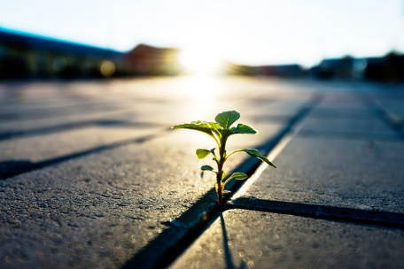
LANGUAGE OF HOPE
“When one door of happiness closes, another opens; but often we look so long at the closed door that we do not see the one which has been opened for us.” — Helen Keller
“All the adversity I’ve had in my life, all my troubles and obstacles, have strengthened me. You may not realize it when it happens, but a kick in the teeth may be the best thing in the world for you.” — Walt Disney
Notes:
WORDS OF HOPE

Slide 33
Resilience
लचीलापन
A story….
Notes:
Which are you? When adversity knocks on your door, how do you respond? Areyou a carrot, an egg or a coffee bean?

Slide 34
LET US SHARE OUR STORIES OF RESILIENCE-
Notes:
DICE DEBRIEF

Slide 35
Mindsets- A STORY
When you change your words, you change your mind-set
विकास की मानसिकता
Fixed mindset
Growth mindset
Research shows mindsets can change……
.”
Notes:
When you change your words, you change your mindset

Slide 36
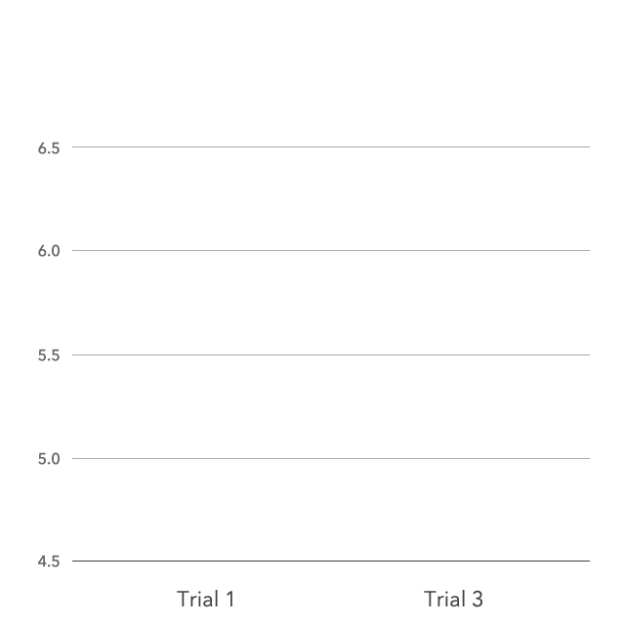
Growth Mindset Praise Graph
Neutral praise
Intelligence Praise
Effort (Process) Praise
Evidence shows that you can really change your intelligence by challenging yourself and learning new strategies.
This is called neuroplasticity- How the brain changes when you learn new things
Notes:
Success had less to do with innate ability and everything to do with mindset. Growth mind-set opens a world of possibilities to all of us

Slide 37
LEARN , UNLEARN AND RELEARN
“The illiterate of the 21st century will not be those who cannot read and write, but those who cannot learn, unlearn and relearn” Alvin Toffler
Notes:
“The illiterate of the 21st century will not be those who cannot read and write, but those who cannot learn, unlearn and relearn”

Slide 38
WORK - LIFE integration
कार्य संतुलन
A tough year has made work more..
Human
Notes:
How can we make HUMANs more effective at work

Slide 39
SELF DEVELOPMENT
What changes people is when their SHOULD, becomes a MUST.
‍‍ ‍‍
“Let him who would move the world first move himself.” ― Socrates.

Slide 40
“A random act of kindness, no matter how small, can make a tremendous impact on someone else's life.”
- Roy T. Bennett
Notes:
What changes people is when their SHOULD, becomes a MUST.
When suddenly, the thing they said should happen, HAS to happen. ‍‍ ‍‍

